Slide 1
Priority of operations with positive and negative integers and decimals
Arithmetic procedures with integers and decimals

Slide 2
how to use Oak lessons

Slide 3
I can calculate using priority of operations, including brackets, powers and exponents with positive and negative integers and decimals.

Slide 4
The additive inverse of a number is a number that, when added to the original number, gives the sum of 0.
Example
8 is the additive inverse of (-8)
Example
(-4.5) is the additive inverse of 4.5
An operation is commutative if the values it is operating on can be written in either order without changing the calculation.
Example
(-3) + 4 + 10 = 10 + (-3) + 4

Slide 5

Priority of operations with positive and negative integers and decimals
Priority of operations with negatives
Priority of operations with negatives and decimals

Slide 6

Priority of operations with negatives
The priority of operations is important as it ensures that everyone can understand and approach a mathematical problem the same way.
( …. )
This priority applies to both positive and negative numbers.
⬚
⬚
⬚
× ÷
+ −

Slide 7
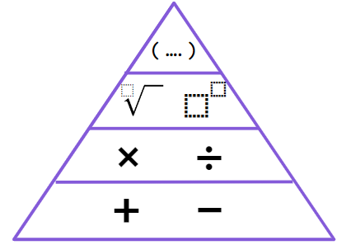
Priority of operations with negatives
When using negatives, we will be using addition with the additive inverse and rewriting the calculation in a more efficient way.
Calculate 12 + (-3) − 5 − (-10)
Rewrite the calculation so we are only using addition.
Here we have 12 + (-3) − 5 − (-10)
+ (- 5)
+10
12 + (-3) + (-5) + 10

Slide 8
Priority of operations with negatives
When using negatives, we will be using addition with the additive inverse and rewriting the calculation in a more efficient way.
Summing the positives
Summing the negatives
12
10
(-3)
(-5)
+
+
(-8)
22
12 + (-3) + (-5) + 10
22 + (-8)
= 14

Slide 9
Priority of operations with negatives
Now let’s mix negatives and addition with another operation.
Calculate 20 − (-5) × 10
Which operation do we do first?
20 − (-50)
Can you rewrite the calculation to only use addition?
20 − (-50)
20 + 50
= 70

Slide 10
Priority of operations with negatives
Work out the answers to the following. Make sure to show all your working out.
100 + (-6) × 5
100 − (-20) ÷ (5)
900 − (-3) × (-10)
100 + (-30) = 70
100 − (-4)
100 + 4 = 104
900 − 30
900 + (-30) = 870

Slide 11
Priority of operations with negatives
Now let’s look at two operations on the same row.
With addition and subtraction, it is easier and more efficient to use the additive inverse and keep all the operations as addition.

Slide 12
Priority of operations with negatives
Now let’s look at two operations on the same row.
With multiplication and division, they have the same priority, but it is better to rewrite the division as a fraction.

Slide 13
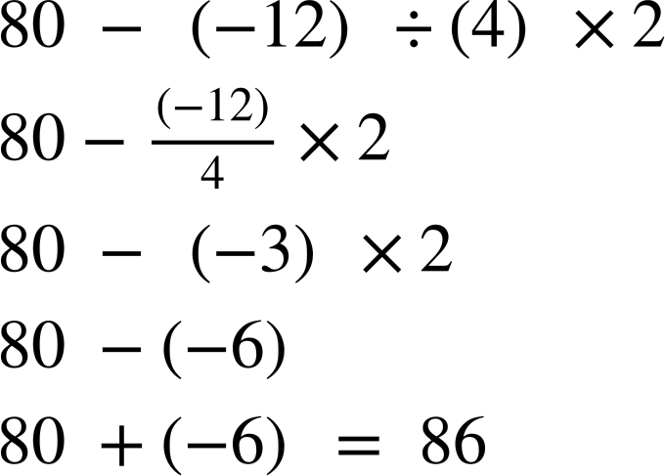
Priority of operations with negatives
With multiplication and division, they have the same priority, but it is better to rewrite the division as a fraction.
Example
Can you rewrite the division as a fraction?

Slide 14
Priority of operations with negatives
With multiplication and division, they have the same priority, but it is better to rewrite the division as a fraction.
Example
What is the next step?

Slide 15

Priority of operations with negatives
With multiplication and division, they have the same priority, but it is better to rewrite the division as a fraction.
Example

Slide 16






Priority of operations with negatives
Jun created a question for his friends.
It’s 115
It’s impossible because, I can’t square root a negative number
It’s 95
Aisha
Izzy
Jacob
Who is correct? Make sure to show your working out.

Slide 17
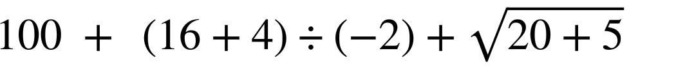


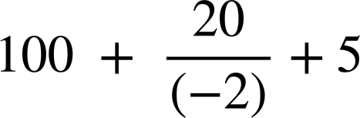
Priority of operations with negatives
Jun created a question for his friends.
It’s 95
Izzy

Slide 18

Priority of operations with negatives
1) Fill in the blanks to make the calculation in the centre 24.
(-240) ÷ (-10)
60 + (-12) × 3
24
4 + (-2) × (-10)
20 − (-8) ÷ 2
40 + (8) × (-2)

Slide 19
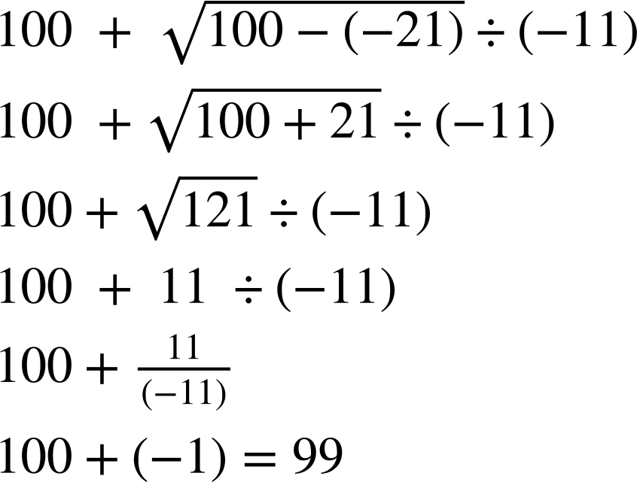
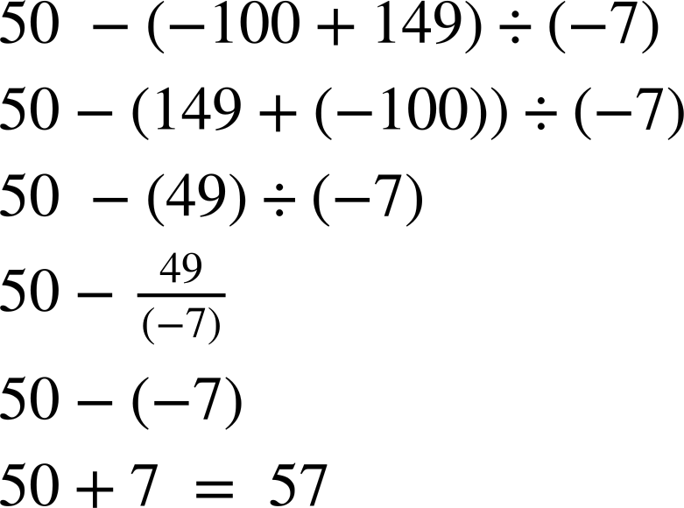
Priority of operations with negatives
2) Work out the following, ensuring you show your working out.
a)
b)

Slide 20
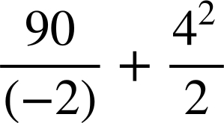
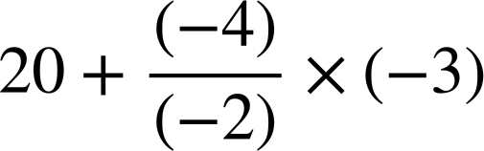
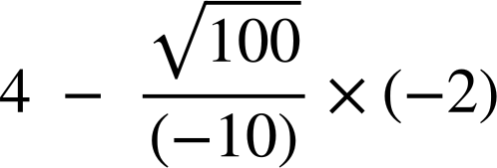
Priority of operations with negatives
3) Fill in the pyramid. The number above the block is the sum of the two below.

Slide 21
Priority of operations with negatives
1) Fill in the blanks to make the calculation in the centre 24.
(-240) ÷ (-10)
60 + (-12) × 3
24
4 + (-2) × (-10)
20 − (-8) ÷ 2
40 + (8) × (-2)

Slide 22
Priority of operations with negatives
2) Work out the following, ensuring you show your working out.
a)
b)

Slide 23
Priority of operations with negatives
3) Fill in the pyramid. The number above the block is the sum of the two below.
(-23) + 16 = -7
(-37) + 14 = -23
14 + 2 = 16

Slide 24
Priority of operations with positive and negative integers and decimals
Priority of operations with negatives
Priority of operations with negatives and decimals

Slide 25
Priority of operations with negatives and decimals
The priority of operations is important as it ensures that everyone can understand and approach a mathematical problem the same way.
( …. )
This priority applies to both positive and negative numbers.
⬚
⬚
⬚
× ÷
This includes decimals too.
+ −

Slide 26
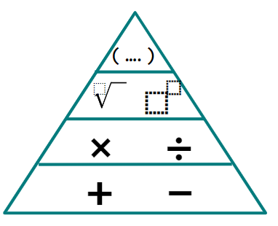
Priority of operations with negatives and decimals
When using negatives, we will be using addition with the additive inverse and rewriting the calculation in a more efficient way.
Example
Here we have 12 − 3.2 + 7.86
Rewrite the calculation so we are only using addition.

Slide 27
Priority of operations with negatives and decimals
When using negatives, we will be using addition with the additive inverse and rewriting the calculation in a more efficient way.
12.00
+ 7.86
19.86
Example
Here we have 12 − 3.2 + 7.86
12 + (-3.2) + 7.86
19.86
− 3.20
16.66
Sum the positives
So this means we have 19.86 + (-3.2) =
16.66

Slide 28
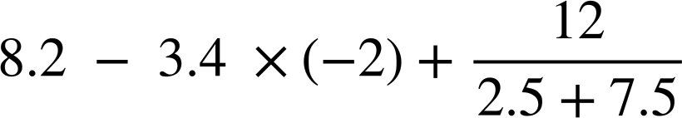
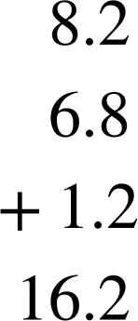
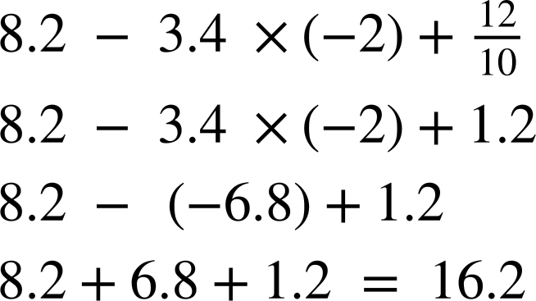
Priority of operations with negatives and decimals
Work out the following, ensuring you show all your working out.

Slide 29
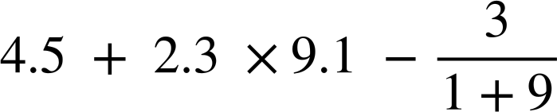
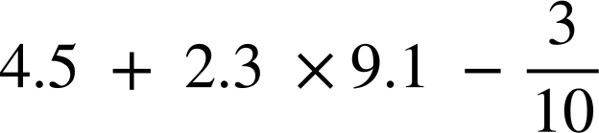
Priority of operations with negatives and decimals
With decimals, you simply need to ensure you add, subtract, multiply and divide using an efficient method.
Example
Implicit brackets
What is the first step?
What is next?

Slide 30
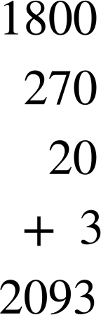
Priority of operations with negatives and decimals
With decimals, you simply need to ensure you add, subtract, multiply and divide using an efficient method.
Example
× | 20 | 3
90 | 1800 | 270
1 | 20 | 3

Slide 31
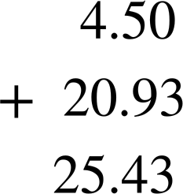
Priority of operations with negatives and decimals
With decimals, you simply need to ensure you add, subtract, multiply and divide using an efficient method.
Example
× | 20 | 3
90 | 1800 | 270
1 | 20 | 3

Slide 32
Priority of operations with negatives and decimals
With decimals, you simply need to ensure you add, subtract, multiply and divide using an efficient method.
Example
× | 20 | 3
90 | 1800 | 270
1 | 20 | 3

Slide 33
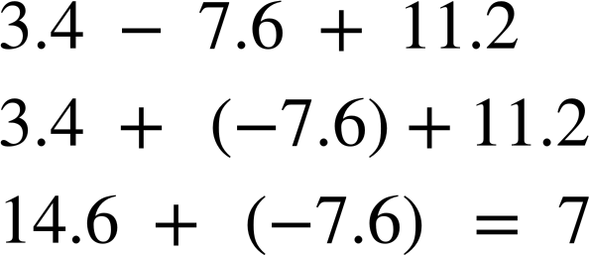
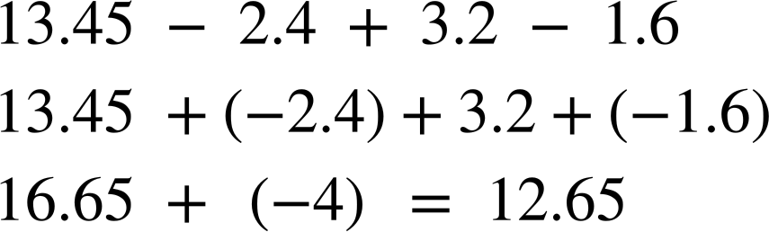
Priority of operations with negatives and decimals
1) Work out the following, ensuring you show all your working out.
2) Work out the following, ensuring you show all your working out.

Slide 34
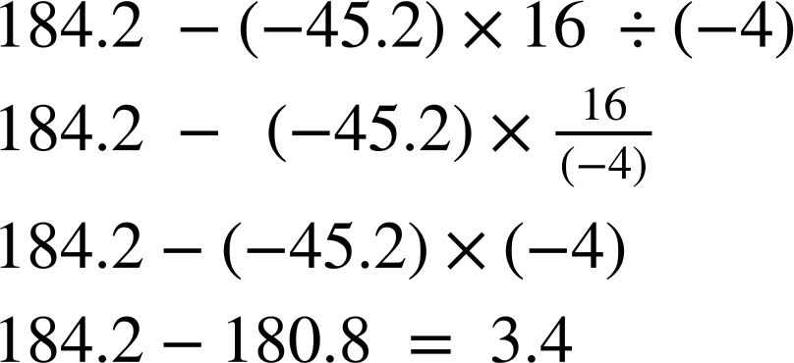
Priority of operations with negatives and decimals
3) Work out the following, ensuring you show all your working out.

Slide 35
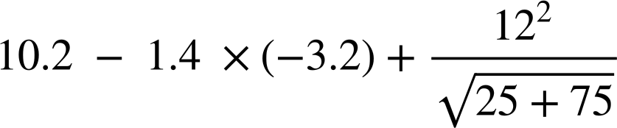
Priority of operations with negatives and decimals
4) Work out the following, ensuring you show all your working out.
5) Create your own two questions using a combination of operations and decimals so the correct answer is 24. You must use decimals and ensure to check your calculation with a calculator.

Slide 36
Priority of operations with negatives and decimals
1) Work out the following, ensuring you show all your working out.
2) Work out the following, ensuring you show all your working out.

Slide 37
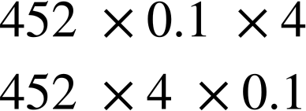
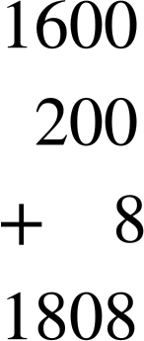
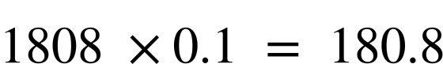
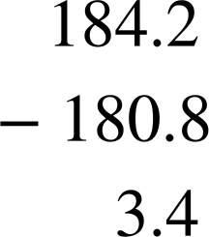
Priority of operations with negatives and decimals
3) Work out the following, ensuring you show all your working out.
× | 400 | 50 | 2
4 | 1600 | 200 | 8

Slide 38
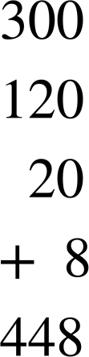
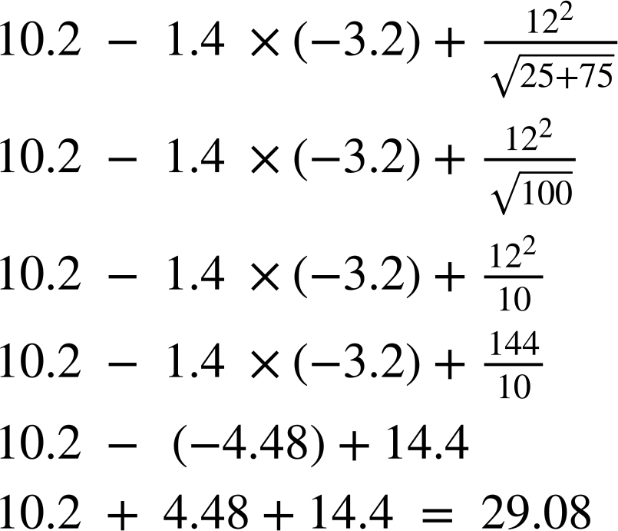

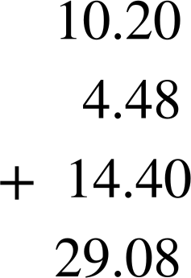
Priority of operations with negatives and decimals
4) Work out the following, ensuring you show all your working out.
× | 10 | 4
30 | 300 | 120
2 | 20 | 8

Slide 39
Priority of operations with positive and negative integers and decimals
The priority of operations is important as it ensures that everyone can understand and approach a mathematical problem the same way.
( …. )
⬚
⬚
⬚
× ÷
This priority applies to positive and negative integers and decimals.
+ −

Slide 40

© Oak National Academy 2023.
Produced in partnership with Mathematics in Education and Industry.
Licensed on the Open Government Licence v3.0, except where otherwise stated. See Oak terms and conditions.

